Slide 1
<OE> Cloud Adoption: Lift & Shift
TO BE COMPLETED BY PROJECT TEAM
TO BE COMPLETED BY ENTERPRISE ARCHITECT
STAKEHOLDERS CIO Project Manager (PM) Business Owner (BO) ISO Others | Xxx (CIO) Xxx (PM) Xxx (BO) Xxx (ISO) Xxx (CFO) etc.
TYPES OF PROJECT | Detoxification Regulatory Specify Regulator New Functionalities New Products Offering
VENDOR NAME | Supplier Name Or Allianz Technology (Please include Contact Person)
IT REPORTING ID
PROJECT DATES | Start (dd/mm/yyyy) | End (dd/mm/yyyy)
PROJECT IT SPEND for Current Year | LCY | EUR
GROUP COMPLIANCE STATUS (in line with GITD definition) | Compliant, or Non-Compliant accepted, or Non-Compliant NOT accepted, or Not applicable
TARGET STATUS (in line with GITD definition) | Unchanged Decommissioned Upgraded-further investment planned New Application
TYPES OF ARCHITECTURE CHANGE | Enhancement (Existing Solution where additional functionalities are added) Upgrade Hardware/Software New Solution
APPLICATION CRITICALITY Target System Availability | 99.5% Is this a business-critical application based on P&R standards?
Does this require DevSecOps Governance Board (DGB) Submission? | Yes No and Why?
GROUP STANDARD APPLIED/TARGET SOLUTION (in line with GITD definition) | *If Non-Group Solution, please define the local solution & reasons for not using Group Solutions
Architecture Review Board
<OE> / Country / Date
TO BE COMPLETED BY ARB TEAM
PHASE |  | DATE
Permit to Build | x | DD/MM/YYYY
Approved | x | DD/MM/YYYY
Rejected | x | DD/MM/YYYY
Filename
Department | Author
<OE> July 19, 2021
For multi-year projects, ARB submission is required annually

Slide 2
Project: Overview
Generic Architecture Design Document
Project Objective/Executive Summary
Give a project brief background & context in terms of why we are doing the project.
If the Project is to address business challenges being faced today, start with the Problem Statement to clearly state the problem to be solved, and the consequence of not doing so.
Provide a brief description of the current initiatives/processes in place if any, and why they are not working effectively
Refer to this link for Global Domain Model to identify business capabilities, and Normative Model V2.0 to assess criticality of business capabilities.
Current Year IT Spend (Itemized Breakdown) | Quantity (Volume / Units) | Unit Cost (€) | PROJECT IT SPEND for Current Year (€K) | Annual Run Costs (Itemized Breakdown) | Annual Run Costs (€K)
TOTAL |  |  |  | TOTAL
License Ph 1 |  |  |  | License
Hardware |  |  |  | Hardware
License Ph 2 |  |  |  | Services
Others e.g Manpower |  |  |  | Others
KEY DRIVERS
Mention Key drivers State the opportunities identified through this project and explain how the organization is thus able to capitalize on these opportunities
BUSINESS BENEFITS
Mention Business Benefits . For ex Launch new and Innovative products, High ROI ,Shorter Change cycles To provide Cost Benefit Analysis (CBA) for Local (non-ITMP), non-regulatory, non-security mandated
BUSINESS CAPABILITIES (GDM)
# | GDM Block | GDM Domain | GDM Sub-Domain | Business Capability | Critical per Normative Model?^ | RTO/ RPO*
1.3.2.1 | Customer centric domains | Sales & Distribution | Performance management | Sales targets & performance management | No | N.A.
1.3.5.3 | Customer centric domains | Sales & Distribution | Distribution recruiting & training | Distributor training | No | N.A.
1.4.4.1/ 1.4.4.2 | Customer centric domains | Policy Management | Underwriting | Individualised/ Standard UW review & decision | Very High | 4h RTO 15m RPO
Attach CBA if Applicable
CONSTRAINTS, DEPENDENCIES & ASSUMPTIONS
Constraints Dependencies Assumptions
SYSTEMS IMPACTED (including decommission)
What are the critical systems/applications that will be impacted by this project? Any servers/applications to be decommissioned and date of decommission
^Very High or High Impact Rating *Recovery Time Objective/Recovery Point Objective
ROADMAP FOR MIGRATING TO GROUP SOLUTION
If any

Slide 3
Architecture Principles
# | Business Principles
1 | E.g. Maximize benefit to the organization …
2 | E.g. Business continuity …
3
4
# | Application Principles
1
2
3
# | Data Principles
1
2
3
4
# | Technology Principles
1 | E.g. Do not migrate toxic components …
2
3

Slide 4
Architecture Assumptions, Risk & Debt
# | PHASE | ARCHITECTURE ASSUMPTIONS
1 | 1 | Implement API strategy for core services to be delivered to internal platform and partner network digital / non-digital
2 | 1 | Further extensions should be built to enable Open API integration where possible.
3 | 1 | Common functionalities will be abstracted out to create a framework and will facilitate reuse for subsequent applications
4 | 1 | Defined service layer and meets performance requirements for the business volumes
# | PHASE | TECHNICAL DEBT
1 | 1 | Are there technical, licencing, lifecycle, support or version issues with the software stack that need addressing?
2 | 1 | Does the Architecture already have significant IT Debt? I.e. are we building more on a bad foundation?
3 | 1 | Are the technologies upon which we are building listed as strategic on the Technology Roadmap?
# | PHASE | ARCHITECTURE RISK | H, M, L | MITIGATION | RESIDUAL RISK H, M, L
1 | 1 | Maintaining different API Versions during interim period and to cater to different devices and partners | M
2 | 1 | Latency issues with requests crisscrossing across SG and TH data centers (especially with CRP, Email and SAP systems) | H | Provide actions for High
3 | 1 | Serving both ITMP and OPUS from MotorFQ where MotorFQ has to maintain both old and new services to connect to both systems | H | Provide actions for High
4 | 1 | On renewal data migration from OPUS to ITMP process to be analyzed | H
5 | 1 | ITMP CISL changes for the APIs that are needed for TH Insurance process | H

Slide 5
Cloud Account Structure
MODIFY THIS DIAGRAM TO DESCRIBE THE AS-IS AND TO-BE PROCESS
Describe Cloud Account Structure to be implemented
Cloud Service Provider: <NAME> Describe Design Concept E.g. Accounts used to control blast radius – Prod, DR, and Dev & Test Accounts per dept to facilitate charge back
<Illustrate Account Structure>

Slide 6
Network Zoning
MODIFY THIS DIAGRAM TO DESCRIBE THE AS-IS AND TO-BE PROCESS
Describe Network Zoning to be implemented
Expectation is that network zoning will adhere to SCC+ zoning concept Design Concept: Out-of-region disaster recovery –OR– In-region disaster recovery due to data residency requirements Utilize all Availability Zones for redundancy Adhere to SCC+ network design Sized with 50% growth capacity
<Illustrate Network Zoning: Regions, VPCs, AZs, and subnets>
Subnets | CIDR | Remarks
Internet Ingress | /26 | Hosts ALBs and security appliances
Transitionary
…

Slide 7
Infrastructure-As-Code
Describe Infrastructure-as-Code to be implemented
Describe infrastructure as code approach: Scope of IaC Location of Repository Framework/Tooling (e.g. Terraform, CloudFormation, etc) DevOps Pipeline
<Illustrate DevOps Pipeline>

Slide 8
MODIFY THIS DIAGRAM TO DESCRIBE ARCHITECTURE
Security View
Describe Security View of the system
Roles | Description
Infra Admin
Read-only
…
Component | Current | Target
DDoS
WAF
Firewall
IDS/IPS
Internet Proxy
Encryption
PAM
IAM
Audit Logging
SIEM
Vul. Mgmt.
Patch Management

Slide 9
MODIFY THIS DIAGRAM TO DESCRIBE ARCHITECTURE
System Monitoring
Describe Planned System Monitoring
System Monitoring Infrastructure Middleware Applications System Performance
<Illustrate System Monitoring tools and data flow>

Slide 10
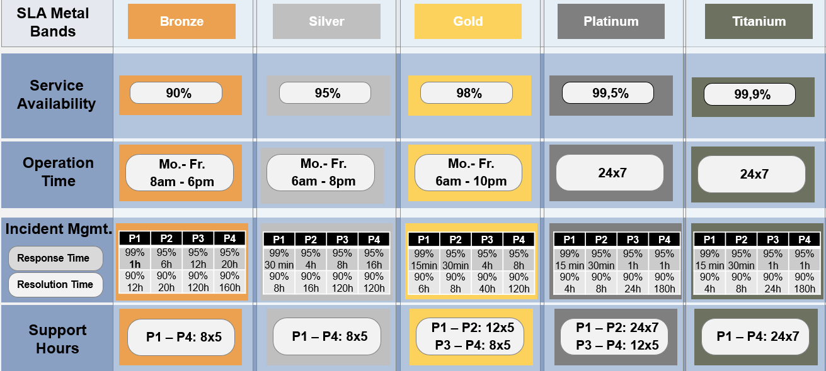
MODIFY THIS DIAGRAM TO DESCRIBE ARCHITECTURE
Incident & SLA Management
Describe Planned Incident & SLA Management
Illustrate Incident & SLA Management Incident Support Team Service Availability Operation Time Incident Management Support Hours SLA Metal Band (where applicable)
Example of An Incident support model
ServiceNow
Agreed Incident Management
Example of AN SLA Management model
Raise Incident to Service Desk via MyAllica/Phone/Email
Log Incident & perform triage. Assign incident to 2nd level support via ServiceNow
Raise Incident to Vendor support via Agreed Incident Management Process
OE
Users
OE Service Desk
(1st Level)
OE Support Teams
(2nd Level)
Vendor Support
(3rd Level)
ServiceNow
Application System
Application Alerts
Send system alerts to Service Desk via Email or to ServiceNow
Product Support
Incident Management
Support & Resolution

Slide 11
MODIFY THIS DIAGRAM TO DESCRIBE ARCHITECTURE
Back-up Patterns
Describe Backup Patterns of the system
Back-up Patterns / Technologies Describe how the Backup patterns and technologies would meet the business required RPO in Project Overview (Slide 2). Database (Managed and self-managed) Disk VM Images Unstructured Data Storage
Pattern 1: Managed Database Backup
Pattern 2: Self-managed Database Backup
Pattern 3: ….

Slide 12
MODIFY THIS DIAGRAM TO DESCRIBE ARCHITECTURE
High Availability
Describe High Availability of the system
High Availability Describe how the high availability patterns and technologies would meet the business required availability in Project Overview (Slide 1).
Pattern 1: Active-Active
Pattern 2: Clustering
Pattern 3: …

Slide 13
MODIFY THIS DIAGRAM TO DESCRIBE ARCHITECTURE
Disaster Recovery Patterns
Describe Disaster Recovery of the system
DR Patterns / Technologies Describe how the DR patterns and technologies would meet the business required RTO and RPO in Project Overview (Slide 2).
Pattern 1: Active-Active
Pattern 2: Pilot-light with DB replication
Pattern 3: AWS Backup Service/CloudEndure

Slide 14
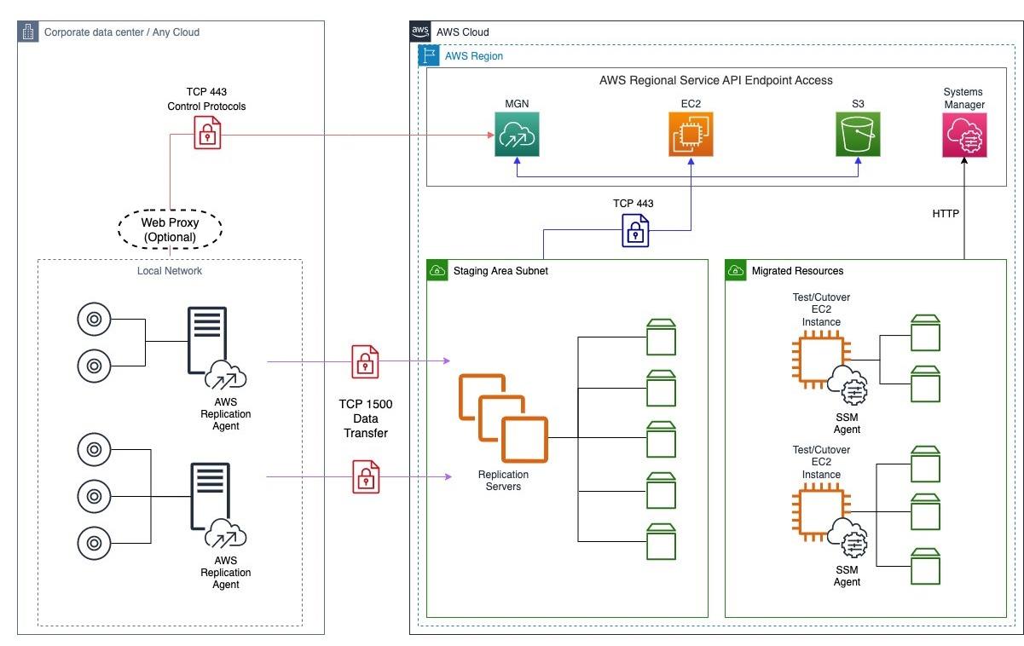
Migration Pattern 1 – Semi-automated Server Migration
Describe Migration Pattern(s) to be implemented
Example: Lift and Shift Migration Strategy service using Application Migration Service (MGN) Configure initial template for Replication Server Install replication agent in Source Server. It will add Source Server into MGN Console Start replication process. It is a block-based replication process. Replication Servers will copy binary of each disks on Source Server and put each disks into same number of EBS disks. When data replication status is Healthy, We can create EC2 Instances to target VPC for Testing or Cutover
3
1
2
4

Slide 15
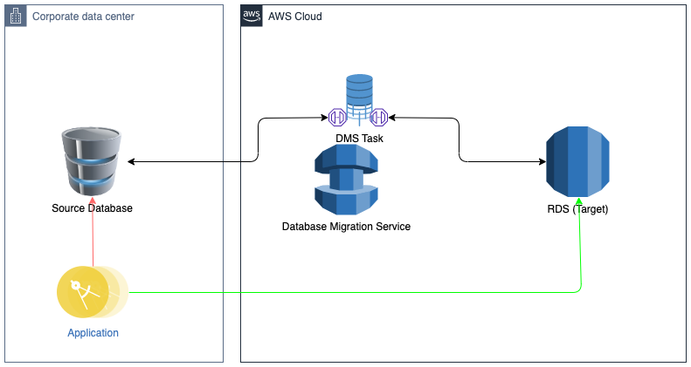
Migration Pattern 2 – Database Replatform using DMS
Describe Migration Pattern(s) to be implemented
Example: Replatform strategy for migrating databases using Database Migration Services (DMS) Create database instance on Amazon RDS Create replication instance in AWS Database Migration Service (DMS) Create endpoints in AWS DMS Create a replication task in AWS DMS Complete migration and cleanup resources
4
3
1
2
5

Slide 16
Application Migration Info
SN | System | RTO/RPO Req. | Backup Pat. | DR Pat. | Migration Pat. | Migration Cost (€) | ITR Reference | Remarks
 | Migration Group 1
1 | Banca Connect | 4h / 15m | Pattern 1 | Pattern 1 | Pattern 1, 2 | 100 | Xyz
2 | Credit Life | 4h / 15m | Pattern 1 | Pattern 1 | Pattern 1, 3 | 50 | Xyz
3 | eAZy Connect | 24h / 30m | Pattern 1 | Pattern 3 | Pattern 2 | 50 | Abc
 | Migration Group 2
1 | …
2

Slide 17
Approach & Timeline
Timeline
Approach
Activity | 2021
 | M1 | M2 | M3 | M4 | M5 | M6 | M7 | M8 | M9 | M10 | M11 | M12
Migration Group 1
Task/Activity
Task/Activity
Task/Activity
Migration Group 2
Task/Activity
Task/Activity
Migration Group 3
Task/Activity
Task/Activity
Decommission Plan

